Slide 1


Online-Examination
Presented by: Daw Kyi Pyar Lwin(Tutor),
Daw Nang Nwe Nwe Soe(Tutor),
Software Technology Department
Date: 11.12.2014

Slide 2

Online-Examination
awp3b(Phase15)
3.9.14 to 7.10.14
2
Notes:
2

Slide 3

Staff Aspect
.
Login into the system
Student Registration
Teacher/Staff Registration
Update Profile
Student Lists
Student Result
3
Notes:
3

Slide 4
Teacher Aspect
Login into the system
Upload new questions
View existing questions
View pass/fail student
View student’s exam information
There is no information for student result, work out in this page.
Student’s list
Update profile
4
Notes:
4

Slide 5

Student Aspect
Login into the system
Fill the profile.
Update profile.
Answer the multiple choice questions.
5
Notes:
5

Slide 6
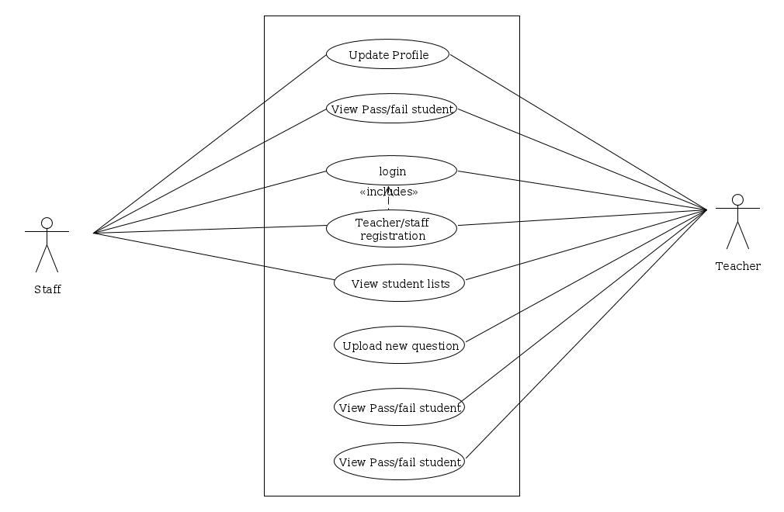
Teacher/Staff Usecase Diagram
6
Notes:
6

Slide 7
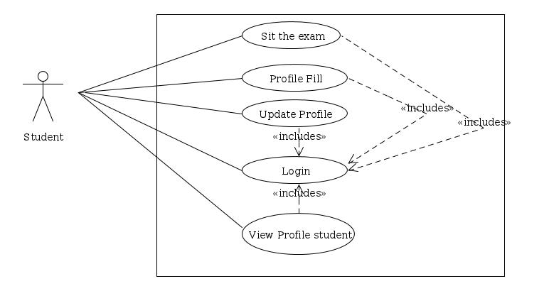
Student Usecase Diagram
7
Notes:
7

Slide 8
Thank You
8
Notes:
8

